Slide 1


Honeypots
Sneha Ranganathan Srinayani Guntaka Sharath Chandra Sarangpur

Slide 2
Introduction
A honeypot is a trap set to detect, deflect, or in some manner counteract attempts at unauthorized use of information systems
They are the highly flexible security tool with different applications for security. They don't fix a single problem. Instead they have multiple uses, such as prevention, detection, or information gathering
A honeypot is an information system resource whose value lies in unauthorized or illicit use of that resource

Slide 3
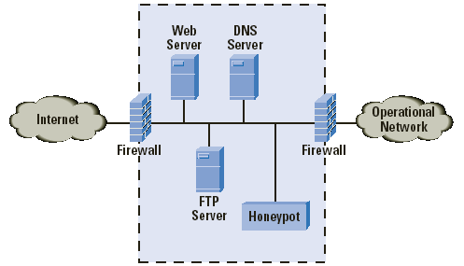
What is a Honey Pot?
A Honey Pot is an intrusion detection technique used to study hackers movements

Slide 4
What is a Honey Pot?(cont.)
Virtual machine that sits on a network or a client
Goals
  Should look as real as possible!
  Should be monitored to see if its being used to launch a massive attack on other systems
  Should include files that are of interest to the hacker

Slide 5
Classification
By level of interaction
    High
    Low
By Implementation
    Virtual
    Physical
By purpose
    Production
    Research

Slide 6
Interaction
Low interaction Honeypots
They have limited interaction, they normally work by emulating services and operating systems
They simulate only services that cannot be exploited to get complete access to the honeypot
Attacker activity is limited to the level of emulation by the honeypot
Examples of low-interaction honeypots include Specter, Honeyd, and KFsensor

Slide 7
Interaction
High interaction Honeypots
They are usually complex solutions as they involve real operating systems and applications
Nothing is emulated, the attackers are given the real thing
A high-interaction honeypot can be compromised completely, allowing an adversary to gain full access to the system and use it to launch further network attacks
Examples of high-interaction honeypots include Symantec Decoy Server and Honeynets

Slide 8
Implementation
Physical
    Real machines
    Own IP Addresses
    Often high-interactive
Virtual
    Simulated by other machines that:
      Respond to the traffic sent to the honeypots
      May simulate a lot of (different) virtual honeypots at the same time

Slide 9
Production
    Production honeypots are easy to use, capture only limited information, and are used primarily by companies or corporations
Prevention
    To keep the bad elements out
    There are no effective mechanisms
    Deception, Deterrence, Decoys do NOT work against automated attacks: worms, auto-rooters, mass-rooters
Detection
    Detecting the burglar when he breaks in
Response
    Can easily be pulled offline

Slide 10
Research
Research honeypots are complex to deploy and maintain, capture extensive information, and are used primarily by research, military, or government organizations.
Collect compact amounts of high value information
Discover new Tools and Tactics
Understand Motives, Behavior, and Organization
Develop Analysis and Forensic Skills

Slide 11
Advantages
Small data sets of high value.
Easier and cheaper to analyze the data
Designed to capture anything thrown at them, including tools or tactics never used before
Require minimal resources
Work fine in encrypted or IPv6 environments
Can collect in-depth information
Conceptually very simple

Slide 12
Disadvantages
Can only track and capture activity that directly interacts with them
All security technologies have risk
Building, configuring, deploying and maintaining a high-interaction honeypot is time consuming
Difficult to analyze a compromised honeypot
High interaction honeypot introduces a high level of risk
Low interaction honeypots are easily detectable by skilled attackers

Slide 13
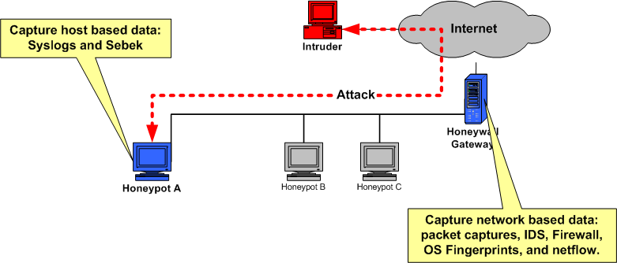
Working of Honeynet – High – interaction honeypot
Honeynet has 3 components:
  Data control
  Data capture
  Data analysis

Slide 14
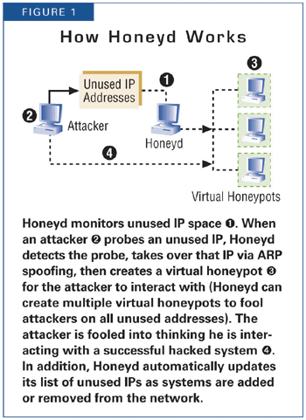
Working of Honeyd – Low – interaction honeypot
Open Source and designed to run on Unix systems
Concept - Monitoring unused IP space

Slide 15
Conclusion
Not a solution!
Can collect in depth data which no other technology can
Different from others – its value lies in being attacked, probed or compromised
Extremely useful in observing hacker movements and preparing the systems for future attacks

Slide 16
References
http://www.authorstream.com/Presentation/juhi1988-111469-ppt-honeypot-honeypotppt1-science-technology-powerpoint/
http://www.tracking-hackers.com/papers/honeypots.html
http://en.wikipedia.org/wiki/Honeypot_%28computing%29

Slide 17

Thank you
Questions

